Slide 1

Maximus - RCC
Notes:
New title slide and took out ea and es wording

Slide 2
Overview
  EEO
  Point of Contact
  Employer
  Knowledge Services and Maximus Partnership
  Employee Website
  ADP

Slide 3

Table of Contents
Overview
Benefit Offerings
Time Worked and Compensation
Attendance Expectations
Office Conduct
Technology Guidelines
Additional Information
Growth Opportunities and Support
E-Verify and FMLA
Notes:
Potential Add: Link to get back to Table of Contents on each slide, explain how to use this feature on table of contents slide

Slide 4
Knowledge Services Overview
Certified Woman-owned Business (WBE)
Founded in 1994
Headquartered in Indianapolis, IN
Service Offerings
  Consortium Management
  Survey Solutions
  Professional and Technical Business Solutions
  dotStaff
  Managed Service Provider (MSP) for Contract Labor

Slide 5
Maximus & Knowledge Services Partnership
Knowledge Services works in partnership with Maximus, who serves as the Employer/Payroll provider for all ES staff in your local RCC.
Maximus RCC Supervisor will direct the day-to-day operational activities for all Eligibility Specialists in the RCC.
Knowledge Services will be the central point of contact regarding all Employee Relations, performance related issues, time entry, etc. Please reach out to your ER coordinator for any questions regarding the following:
  Payroll
  Benefits
  Policies
  Workplace Concern or Injury
  Call Off Procedures
  Any employer related questions

Slide 6
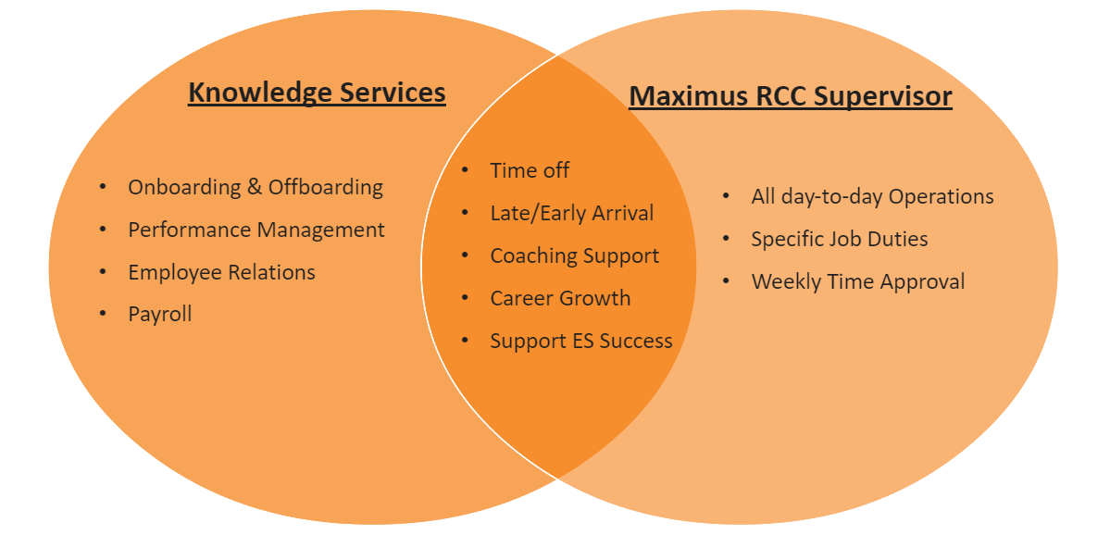
Knowledge Services & DFR Roles
Knowledge Services’ Role
  Payroll processing
  Employee Onboarding and Off-boarding
  Employee Relations – Dedicated Point of Contact
  Performance Management
Maximus RCC Supervisors’ Role
  Manage the day-to-day work product
  Time-off approval
  Approve/deny time submitted by employee

Slide 7
Knowledge Services as your Employer
You will be a Knowledge Services employee for approximately 180 days.
Maximus will determine who will transition (to Maximus) based upon Maximus’ hiring criteria.
  If anyone is not selected to transition to Maximus, your work assignment with Knowledge Services will be complete.
All recognition, performance, and/or employee issues will be addressed by Knowledge Services and Maximus - RCC.
Any and all issues, questions, concerns regarding your employment shall be directed to Knowledge Services.
  i.e. pay, policies, performance, benefits, etc.

Slide 8
Information about Maximus
If you are selected to convert to Maximus, here are a few things you can look forward to:
Maximus was named one of the best employers for diversity by Forbes in 2021 and 2022!
Encouraging diversity, equity, and inclusion (DE&I) is a personal and business imperative for Maximus.
Maximus is proud to create a better life for families through the Children’s Heath Insurance Program (CHIP).
Maximus created the Maximus foundation in 2000 that provides financial support for nonprofit organizations and charities that share our commitment to helping disadvantaged populations and underserved communities.
Maximus remains dedicated to providing all employees with an engaging and supportive work environment which celebrates achievements and allows time to have fun!
  **Employee engagement activities may differ from region to region and are based on management approval.
Recurring Activities: | Sessional:
Employee of the Month | Halloween Trunk or Treat
Birthday Celebration​ | Food Drives
95 (quality) and Above Club​ | Spirit week with the state
Recognition Board​ | National Pancake Day
On the Spot Awards​ | School Supply Drives
Customer Service Appreciation Week | Hot Cocoa bar and cubicle decorations
Perfect Attendance Breakfast/Lunches | Staff Appreciation Day

Slide 9



Information about Maximus (cont.)

Slide 10
Employee Website
In your Welcome Email that you will receive from your Employee Relations Point of Contact, you receive a link to the Employee Website:
  RCC Employee Portal Preview – Knowledge Services
  The Employee Website is an excellent tool for you to reference during your position, so please be sure to add it to your ‘Favorites.’
This website provides the following:
  Time Entry guidelines and instructions
  ADP information
  Guides and Policies, including a copy of this orientation
  Holiday Schedule
  Referral Program information

Slide 11
ADP
During your employment with Knowledge Services, you will utilize ADP for the following items:
  View and access pay stubs
  Update direct deposit, tax forms and personal information
  Enroll in benefits
  View your PTO balance

Slide 12
Section Recap
True/False: Maximus Management directs the day-to-day operations on-site.
Where can employees find holiday schedules, PTO, tax forms, etc.?
A1: True
A2: ADP

Slide 13
Benefit Offerings
Holidays
Insurance
PTO
Information Updates

Slide 14
Holidays
Observed Holidays where all RCCs will be closed:
  New Year’s Day
  Martin Luther King Jr. Day
  Good Friday
  Primary Election Day
  Memorial Day
  Independence Day
  Labor Day
  Columbus Day
  Election Day
  Veteran’s Day
  Thanksgiving Day
  Day after Thanksgiving
  Christmas Eve
  Christmas Day
Notes:
Potential: include what holidays are paid holidays

Slide 15
Holidays
If the week includes one of the paid Holidays, you will receive 8 hours of holiday pay.
Knowledge Services will always be responsible for processing any of your paid holiday hours.
You should not enter any Holiday time into dotStaff.
To be eligible for holiday pay, employees must work or be in a scheduled and approved leave status on the last scheduled day immediately preceding the holiday and the first scheduled day immediately following the holiday.
Any questions regarding holiday pay eligibility, please direct to your Maximus supervisor.
Notes:
Potential: include what holidays are paid holidays

Slide 16
Insurance
Plan meets the Minimum Essential Coverage mandate under the Affordable Care Act (ACA).
You will use ADP to elect or decline coverage, which will be sent to you after 30 days of employment. You will receive an email to your personal email address regarding this information.
We partner with MetLife Pet Insurance to provide team members with flexible pet insurance plans, you can work directly with MetLife to enroll as this is not a benefit that will be deducted from your weekly paycheck. Please see the attached MetLife Booklet to learn more.
After a 60-day waiting period, coverage becomes effective at the start of the following month.
Panabridge Medical, Delta Dental, and VSP Vision coverage.
  Voluntary Term Life Insurance through Mutual of Omaha
You are unable to make changes unless it is the open enrollment period or you have a qualifying event (marriage, loss of other health coverage, etc.)
  Panabridge Customer Service: 1-877-385-3601
  Group ID: SE377
Notes:
Add benefit focus info??

Slide 17
Information Updates in ADP
If you need to make any of the following changes to your personal information, you can do so on your home page in ADP:
  Name
  Address
  Phone Number: Work and Personal
  Email Address: Work and Personal
  Marital Status
  Number of Dependents
  Individual(s) to Notify in Case of Emergency
  Beneficiary Designations
Notification of these changes must be made within 30 days of occurrence
Notes:
Changes: removed arrows from list

Slide 18
Section Recap
Who is responsible for processing your holiday pay?
When will employees receive an email about enrolling in benefits?
True/False: Employees will advise Maximus of personal changes (name, address, number, martial status, etc.?
1A: Knowledge Services.
2A: After 30 days of employment.
3A: False, you can make all changes in ADP.

Slide 19
Time Worked and Compensation
Time Entry Process
Payment Options
ADP
Time Off Requests

Slide 20
Time Entry Process
All Knowledge Services employees will utilize two different time keeping systems while employed.
Deltek is the system used to enter time for Maximus. If you have any questions/concerns, please reach out to your Maximus HR Specialist.
dotStaff is the system used to enter your time worked each week to ensure you are paid on a weekly basis through Knowledge Services.
In order to activate your new account, an Administrator or User at KS must first create it.
Once your account has been created, you should receive an email from “Admin” containing your Login Email as well as your Activation Code. You may not register without your unique Activation Code and Login Email.
  Navigate to my.dotStaff.com
  Select the Activate Account hyperlink.
  Complete the Activate Account Form in its entirety.
  Go to the Employee Site for full dotStaff ™ account activation instructions, as well as the dotStaff ™ Time Entry Guide.

Slide 21
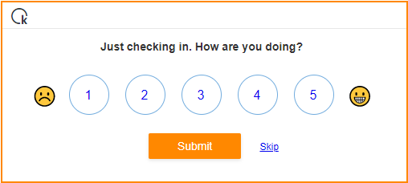
dotStaff – How are you doing?
The first time that you log into dotStaff each week, you will see a pop-up box. The purpose of this box is for our team to check in with you and see how you are doing at work.
The feedback is in the form of a number scale, from 1 being bad and 5 being great. All you will need to do is select the number that most relates to how you are feeling in the office that week and click submit. If you wish to not answer, you may also select skip.
This check-in help us better understand your needs in the moment and allows us more insight on a weekly basis.

Slide 22
Time Submittal - dotStaff™
Notify Knowledge Services if time was entered in dotStaff™ past the deadline each Monday at 10:00 a.m.
If you enter time that is not for the current payroll week, notify Knowledge Services because this time is not automatically pulled for payroll.
Complete Timesheet
Checks are mailed out Wednesday afternoon or direct deposited Friday
Payroll is processed based on your approved timesheet.
Submit Time for Approval by Monday 10 AM EST
If timesheet is denied by Maximus RCC Supervisor, it is employee’s responsibility to correct

Slide 23
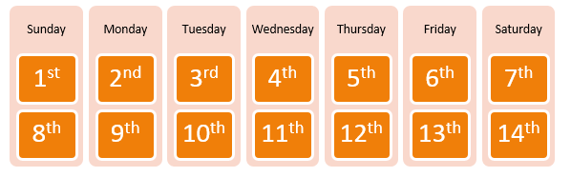
Time and Pay
Time is due in dotStaff™ by 10:00 a.m. EST on Mondays
  You are expected to report all actual hours worked- no more and no less- for each day worked.
  Any time entered late must be brought to your Employee Relations Representative’s attention.
  Late time entry can delay the processing of your pay.
Paychecks are issued every Friday
  For example, you submit time for the week of the 1st by Monday at 10:00am EST on the 9th, you receive your direct deposit on the 13th or your check is mailed on the 11th.
  Please Note: If you are set up for direct deposit, the funds will be available in your account by noon each Friday. If you are to receive a live check, those are mailed via USPS on Wednesday afternoon.

Slide 24
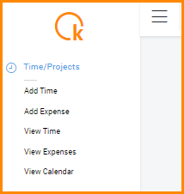
How to Add a Timesheet in dotStaff™
Go to “Time/Projects”
Click “Add Time”

Slide 25
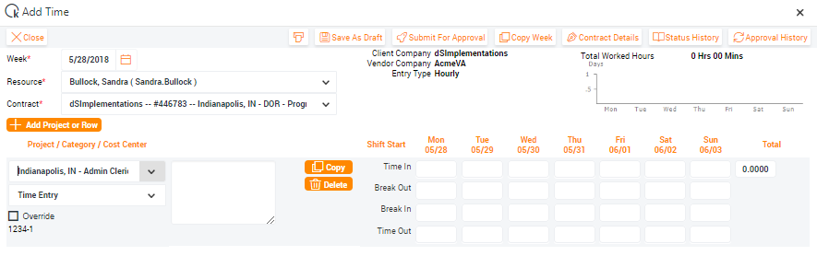
Blank Timesheet
Easily enter your shift times
Time In → Break Out
Break In → Time Out
You will have the option to either:
Save time as a draft
Submit for approval.
Only submit Regular Hours – KS submits “PTO Hours” and “Holiday Hours”

Slide 26
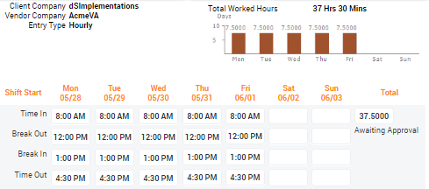
Time Entered
You will see awaiting approval once time is submitted for the week.
As you successfully submit your time, a bar graph will appear with daily hours entered.

Slide 27

Payment Options
Direct Deposit & Global Pay Card
Fridays
Recommended
Paycheck Statements available online through ADP
“Live” Checks
Checks mailed out on Wednesday afternoons
ADP mails from Elk Grove, IL
Changing Payment Options
Your direct deposit form has already been completed during the onboarding process.
ADP includes access to the electronic form used to update payment options.
Once you have completed the form, please contact your ER Coordinator either by email or phone to confirm it has been received.
Your point of contact will be able to verify that your completed form has been received and notify you when the information is updated.

Slide 28
Wage and Tax Statements
As a W-2 employer, Knowledge Services (KHI Solutions, Inc.) automatically withholds and pays the applicable employee income taxes that are required by taxing authorities.
Your W-2 will be available in ADP website no later than January 31st. Due to online accessibility, copies of W-2s will NOT be mailed out.
In order to update tax information, please access the appropriate forms in ADP.
  Once you have completed the form, please contact your ER Coordinator either by email or phone.
  Your point of contact will be able to verify that your completed form has been received and notify you when the information is updated.

Slide 29
Paid Time Off Use
All KS employees start accruing PTO on their first day of employment, which is accrued based on every hour that you work.
Employees are expected to utilize PTO for any approved time off work for vacation, illness, or personal business.
PTO must be utilized for all absences and time off is approved based on operational need.
PTO balances can be seen in ADP.
As a general guideline, unpaid time off should only be used for emergencies or prior approved absences. Unauthorized leave may be subject to disciplinary action.
Once approved for time off, you will submit the Maximus INEO Tracker.
Your PTO balance will be paid out at the end of your employment with Knowledge Services, unless you leave prior to your transition to Maximus – RCC, then at that time all time will be forfeited at the end of employment with Knowledge Services. Your PTO payout will be paid the week following your final paycheck.
180-day position with Knowledge Services
Accrual Rate: .03846
Projected PTO in Days: 5

Slide 30
Time Off Process
All time off requests are reviewed by both Knowledge Services and Maximus.
If you are needing to request time off, please submit the Maximus link:
  INEO - Attendance Tracker (smartsheet.com)
Once your time off request has been received, it will be reviewed based on PTO availability and only approved if there is enough PTO to cover the absence.
If your time off is approved by both Knowledge Services and Maximus, Knowledge Services will ensure your PTO is paid out.
If you have any specific questions regarding a PTO request, please follow up with your Maximus supervisor.

Slide 31
Call Off Procedure
In the event that illness, inclement weather, or emergency prevent you from reporting to the RCC at your scheduled time, please follow the proper call off procedure prior to 7:30am.
Maximus Attendance Tracker: INEO - Attendance Tracker (smartsheet.com)
Must be completed by 10am, or could result in a NCNS
Once time off is submitted in the INEO Tracker, Knowledge Services will ensure PTO is paid out based on your balance.
Knowledge Services Email: RCC@knowledgeservices.com
Provide in email:
First/Last Name
Reason for call off
RCC Location Name
Supervisor Name

Slide 32
Section Recap
What is the timekeeping system that KS uses?
When are timesheets due to make sure you are paid on time?
How do you request PTO and where can you find your balance?
Who do you contact when missing work, leaving early or coming in late?
True/False DotStaff is for ONLY time physically worked?
1A: DotStaff.
2A: Monday at 10:00 AM.
3A: PTO requests will need to be submitted through the Maximus INEO Tracker, and balances can be seen in ADP.
4A: RCC@KnowledgeServices.com
5A: True, please leave your timesheet blank for PTO and holiday. Our dedicated Payroll team will process separately.

Slide 33
Attendance Expectations
  Attendance
  Call Off Policy
  Call Off Procedure

Slide 34
Attendance Expectations
Hours of operations are 8am-4:30pm. You are expected to be logged on and ready to work at 8am.
  30-minute lunch and (2) 15-minute breaks.
  Information on break and lunch times will be provided by your RCC Supervisor.
  Any adjustment to your normal work schedule (i.e. shortened lunch, late arrival, etc.) requires prior approval from your Maximus RCC Supervisor and Knowledge Services.
  Employees who need to leave work due to illness, injury or any unscheduled reason must immediately notify their Maximus RCC Supervisor and Knowledge Services for approval prior to leaving.
You are responsible for maintaining excellent attendance, which means:
  Reporting to work on time as scheduled
  Returning from breaks and lunch on time
  Working until the end of the scheduled workday
  Requesting time off in advance
  Attending all New Worker Training Sessions

Slide 35
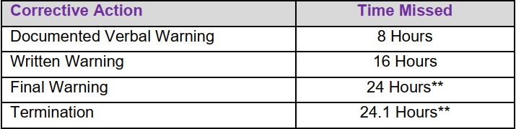
Maximus Attendance Policy - Training
Training Attendance:
** Exceptions may be made for unscheduled absences (up to 8 hours), after the 24 hours threshold has been reached if an employee is meeting standards: average of 90% on gateways, 90% on quality scores and no disciplinary issues
If an employee misses more than (24) hours of training, it will result in immediate termination
Send any doctors’ notes, court/jury duty statements, and any other form of documentation to Knowledge Services only.

Slide 36
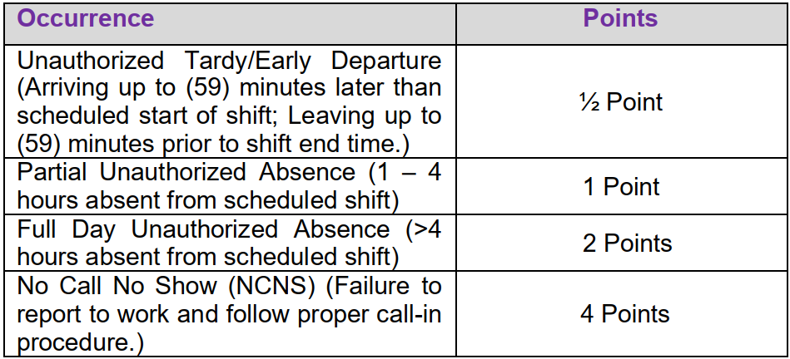
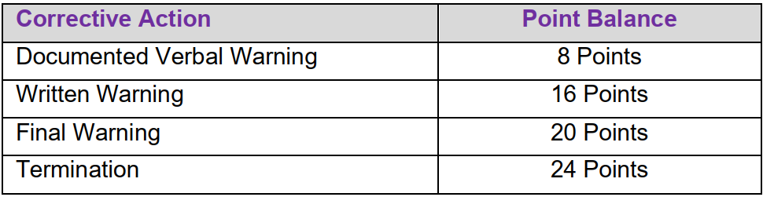
Maximus Attendance Policy – Nesting & Floor Production
Absences and tardiness in Nesting and/or Floor Production will result in point infractions and could move to Progressive Discipline:
For any questions regarding the point system, please reach out to your Maximus supervisor.
Employees accumulate points on a 180-day rolling period.
Unauthorized time is anytime off without pre-approval, extenuating circumstances will be reviewed on a case-by-case basis.
Notes:
Move into call off procedures??

Slide 37
Section Recap
True/False: Is there excused time during training?
Who do employees reach out to regarding how many points or hours of attendance are allowed to be missed?
What are the hours of operation?
1A: False, unfortunately no matter the circumstance, any time missed in training will be counted against the 24 hours. Once in nesting/production if you can provide documentation there are ways to offset points.
2A: Maximus Management.
3A: 8:00am-4:30pm.

Slide 38
RCC Conduct
  Professionalism and Customer Service
  Call Avoidance Policy
  Dress Code and Professional Attire
  Confidentiality
  Harassment
  Alcohol and Drug Free Workplace

Slide 39
Equal Employment Opportunity
Knowledge Services does not discriminate on the basis of:
  Race
  Color
  Religion
  Sex
  Sexual Orientation
  Pregnancy
  Marital Status
  National Origin
  Veteran Status
  Age
  Physical or Mental Disability
  Any other status that is unlawful by applicable Federal, State, and Local Laws

Slide 40
Standards of Performance and Conduct
We have established workplace standards of performance and conduct, as a means of maintaining a productive and cohesive working environment.
Any performance issues or policy violations could result in disciplinary action up to and including immediate termination.
Throughout the 9-week training course, employees will be required to complete a test at the end of every gateway. The tests will be open book and employees will receive two attempts to pass each gateway.

Slide 41
Professionalism and Customer Service
Knowledge Services employees are expected to be professional and treat every co-worker with respect.
Please maintain a positive and respectful attitude in all interactions with coworkers and clients while at the RCC.
  This includes all phone interactions with clients and conversations in Teams chat with co-workers.
Employees are also expected to work cooperatively with coworkers to meet the needs of all clients.
Personal matters and private client information should not be discussed within the hearing range of clients on the phone.
Inappropriate comments and profane language are also not tolerated in the workplace, especially toward clients or within the hearing range of clients on the phone.

Slide 42
Call Avoidance Policy
If assigned to phones you will be in available status to receive calls:
  If you are not taking calls or performing a task you should be in an Aux Code status with the proper reason until you return:
    Not Ready – At break
    Not Ready – At lunch
    Not Ready – Away from desk
    Not Ready – Quality session
    Not Ready – In a training session
    Not Ready – In a meeting
    Not Ready – Gone Home
    Not Ready – On Vacation
  You may only use the following codes with approval by management:
    Available, no ACD (Automatic Call Distribution)
    Non task work
Notes:
Wording?

Slide 43
Call Avoidance Policy
The following actions are considered call avoidance and is prohibited:
  Employee intentionally disconnects a call
  Employee intentionally mutes the consumer once a call is transferred to their line
  Employee intentionally transfers calls back to the queue or to another queue
  Employee refusing to use the language translation services for non-English calls
  Employee intentionally tampers with the phone/system causing the inability to receive calls
  Employee walks away from their workstation while in available status
Non-compliance could result in disciplinary action up to and including termination of employment.
Notes:
Wording?

Slide 44








Dress Code and Professional Attire
Eligibility Specialist Dress Code is business casual.
Your attire and grooming are to be neat, clean and appropriate for your work situation as determined by your Maximus RCC Supervisor.
If you have questions or concerns about the dress code, you are encouraged to contact your Maximus RCC Supervisor.
Notes:
Add – examples of what not to wear – do’s and don’ts

Slide 45
Confidentiality
You will be in contact with personal, private and confidential client information as a routine part of your job duties. Confidential Information includes, but is not limited to, personal information such as:
  Date of Birth
  Social Security Number
  Identification Cards
  Individual Health Information
You will receive training and additional important information on the importance of maintaining confidentiality and upholding the security of information, as well as your obligations under the Health Insurance Portability and Accountability Act (HIPAA), state and federal law, and other relevant FSSA and DFR regulations and policies regarding the safeguarding of confidential information.
You are to abide by such policies and procedures and acknowledge that you may be subject to disciplinary action or termination in the event of any violation of the above.

Slide 46
Information Resources Use Agreement (IRUA)
The IRUA is the Information Resources Use Agreement that you signed when you started your position with the DFR and applies to the appropriate use of state hardware, software, data, information, network, personal computing devices, phones and other information technology.
Examples of violations could include the following:
  Improperly creating public assistance (PA) cases is a direct violation of state policies and procedures (PA applications are to be created by the clients on computers provider at DFR)
  Submitting a false statement into a PA is a criminal violation of Indiana Criminal Code 35-43-5-7, which is welfare fraud - Improperly accessing PA cases and/or the use or disclosure of such information is a breach of the Health Insurance Portability and Accountability Act (HIPAA). Protected health information (PHI) under HIPAA includes any individually identifiable health information. Identifiable refers not only to data that is explicitly linked to a particular individual. It also includes health information with data items which reasonably could be expected to allow identification of an individual.
If you have a case or are an authorized representative for someone with a case, always work through the RCC for any assistance. If you need support from a local office, please work directly with a SEC/SEM.

Slide 47
Sexual Harassment
Unwanted sexual advances
Offering benefits in exchange for sexual favors
Making or threatening reprisals after a negative response to sexual advances
Visual conduct: leering, making sexual gestures, displaying of sexually suggestive objects or pictures, cartoons or posters
Verbal conduct: making or using derogatory sexual comments, epithets, slurs, and jokes
Verbal sexual advances or propositions
Verbal abuse of sexual nature, graphic verbal commentaries about an individual’s body, sexually degrading words used to describe an individual, suggestive or obscene letters, notes or invitations
Physical conduct: touching, groping, assaulting, impeding or blocking movements

Slide 48
Other Forms of Harassment
If you witness or experience any form of harassment:
No harassment is tolerated.
Other forms of harassment include:
Racial or Ethnic Harassment
  Slurs, jokes, or other verbal or physical conduct relating to an individual’s race, national origin or ancestry
Religious Creed
Physical Disability
Medical Condition
Marital Status
Age
Report harassment to your Maximus RCC Supervisor and Knowledge Services
Investigation is conducted
Further action determined by KS in partnership with Maximus
Retaliation is prohibited.

Slide 49
Alcohol & Drug Free Workplace
Actionable offenses:
  Employees, agents, contractors, vendors and visitors are prohibited from the unlawful manufacture, distribution, dispensation, possession or use of alcohol and/or controlled substances on Knowledge Services’ or clients’ or leased property.
  No one shall report to work under the influence of alcohol and/or illegal drugs.
  Unlawful substances are not to be stored in a vehicle on Knowledge Services’ or our clients’ or leased premises.
Notes:
Wording?

Slide 50
Section Recap
True or False: Employees can leave their phone status on “Gone Home” all-day.
True/False: You must pass your gateways with a 90% or higher.
Does the State of Indiana have full access to your computer?
1A: False, your phone status must reflect the appropriate reason you are unavailable.
2A: True, you will receive only 2 attempts to pass your gateway, and if you don’t, unfortunately you will be released from the project.
3A: True, you signed the IRUA agreement before starting, stating the appropriate use of all State hardware and software.

Slide 51
Technology Guidelines
  Internet and Telephone Code of Conduct
  Social Media Policy

Slide 52
Technology, Internet, and Telephone Code of Conduct
Computer equipment as well as all other client or Knowledge Services equipment is to be used strictly for company related business.
  This includes the appropriate utilization of Microsoft Teams chat. Inappropriate conversations in Teams is strictly prohibited.
Systems are intended solely for business use. Personal or improper use of these systems may result in disciplinary action.
Reviewing confidential information in the state systems for your own personal use and information is prohibited.
Accessing cases of friends and family members is prohibited.
Abuse of your telephone privilege may result in disciplinary action.
Cell phone use during work hours is to be limited to break and lunch time only. Ringers must be turned off and phones should not be visible in the work area during scheduled work hours.
Taking photographs in the RCC is strictly prohibited due to confidentiality.
The following items are not allowed in the work area:
  Personal Laptop, Kindle, Nook, iPad, Handheld Games, and other devices deemed by management to interfere with job responsibilities
Notes:
What is PA?

Slide 53
Social Media Policy
Refrain from posting on social media about your job.
All data and information entered, received, or stored on company equipment is the property of the agency and there should be no expectation of privacy.
Access social media only on personal devices and only during breaks or lunch.
Do not use your agency email address for personal social networking accounts.
Stop and think before posting. If you feel a post crosses into questionable territory, we encourage you to refrain from posting that information.
Notes:
Wording

Slide 54
Section Recap
True/False: Employees can have their personal phone out and open during the workday.
2. Can you use your work email for your Instagram account?
3.True/False: Employees can look up their cousin's benefits in the state system.
1A: False, you will need to contact KS immediately, and we will get you in contact with Medcor.
2A: No, please do not use your work email for any personal networking.
3A: False, accessing cases of friends and family members is prohibited and will result in immediate termination.

Slide 55
Additional Information
  Workplace Safety
  Workplace Injury
  COVID-19 Office Safety
  Employment Earnings and Verifications

Slide 56
Workplace Safety
Our primary concern is the health and safety of our employees.
Report unsafe work conditions to your point of contact immediately.
Be sure your office and co-workers are following all safety standards on a daily-basis.
Read and follow the safety standards outlined in the Employee Handbook.

Slide 57
Workplace Injury
Medcor is a 24/7 Injury Triage Service for employees to use if injured at work.
If you are injured at work, Medcor will connect you with a Registered Nurse to advise you on treatment.
If your injury requires further treatment, your point of contact will connect you with an in-network medical facility.
You are required to contact Medcor to report an injury as soon as possible.
Medcor 24/7 Injury Triage Service:
800-775-5866
In an emergency, Dial 911

Slide 58
COVID-19 Office Safety
If you get tested or are planning on getting tested for COVID-19, please contact Knowledge Services immediately.
If you have been exposed to someone who has tested positive for COVID-19 or is getting tested, please contact Knowledge Services immediately and do not return to the RCC without approval.
If you are suffering from symptoms of COVID-19 (fever, dry cough, fatigue, coughing up phlegm, nausea, headache, shortness of breath, bone or joint pain) you should not come to work, contact your Maximus RCC Supervisor and Knowledge Services immediately and seek out advice from a health care provider.
We are navigating unprecedented times, and it is essential to continue open communication with Knowledge Services for proper direction at all times. In addition, please notify your Maximus RCC Supervisor and Knowledge Services with any safety questions or concerns.
Please comply with all CDC guidelines and recommendations regarding facial coverings, and please note these guidelines are subject to change.
Knowledge Services will partner closely with Maximus to ensure that all working conditions are safe for our employees.

Slide 59
Employment Earnings and Verifications
Contact Knowledge Services for any Employment Verification Forms to be completed by employer.
If you need employment verification on letterhead, email Knowledge Services with the specific information that you need.
Please note, there is a three (3) business day turn around policy for the completion of these requests.

Slide 60
Section Recap
True/False: If an employee is injured, it should not be reported to KS.
1A: False, you will need to contact KS immediately, and we will get you in contact with Medcor.

Slide 61
Growth Opportunities and Support
  Growth Opportunity
  Employee Check-Ins
  Contact Information

Slide 62
Growth Opportunity
Your position with Knowledge Services provides you with an excellent career opportunity with Maximus.
180 Day Goal
KS Employee
180 Days – Transition to Maximus

Slide 63
What’s Next?
Welcome email
  Sent from Recruiting Team
  Will include first day details:
    - Items needed for first day, Teams link for training, RCC address, parking details
  Greeted by HR Specialist on first day
Employee Relations Introduction email
  Sent from RCC Employee Relations team on first day of employment
  Will include ADP information, call off procedure, etc.
  Point of contact moving forward

Slide 64
Employee Check-ins
Your Knowledge Services Employee Relations Coordinator will contact you regularly via email/phone to check in to address any concerns or questions.
Notes:
Combine this slide with Contact information OR change header and explain office visits

Slide 65
Contact Information – Employee Relations
  RCC@KnowledgeServices.com
We are pleased that you have
joined our company!
We look forward to working with you.
Please know we are here
to answer any questions.
Notes:
Fix and combine

Slide 66
FMLA and E-Verify
  FMLA
  E-Verify

Slide 67


E-Verify – USCIS Employment Eligibility Verification
- In accordance with federal regulation, the following information is available for all employees to review.
- E-Verify Poster – Notice to Employee (left)
- Right to Work Poster – Department of Justice (right)

Slide 68

E-Verify – USCIS Employment Eligibility Verification
In accordance with federal regulation, the following information is available for all employees to review.
E-Verify Poster – Notice to Employee (left)
Right to Work Poster – Department of Justice (right)

Slide 69
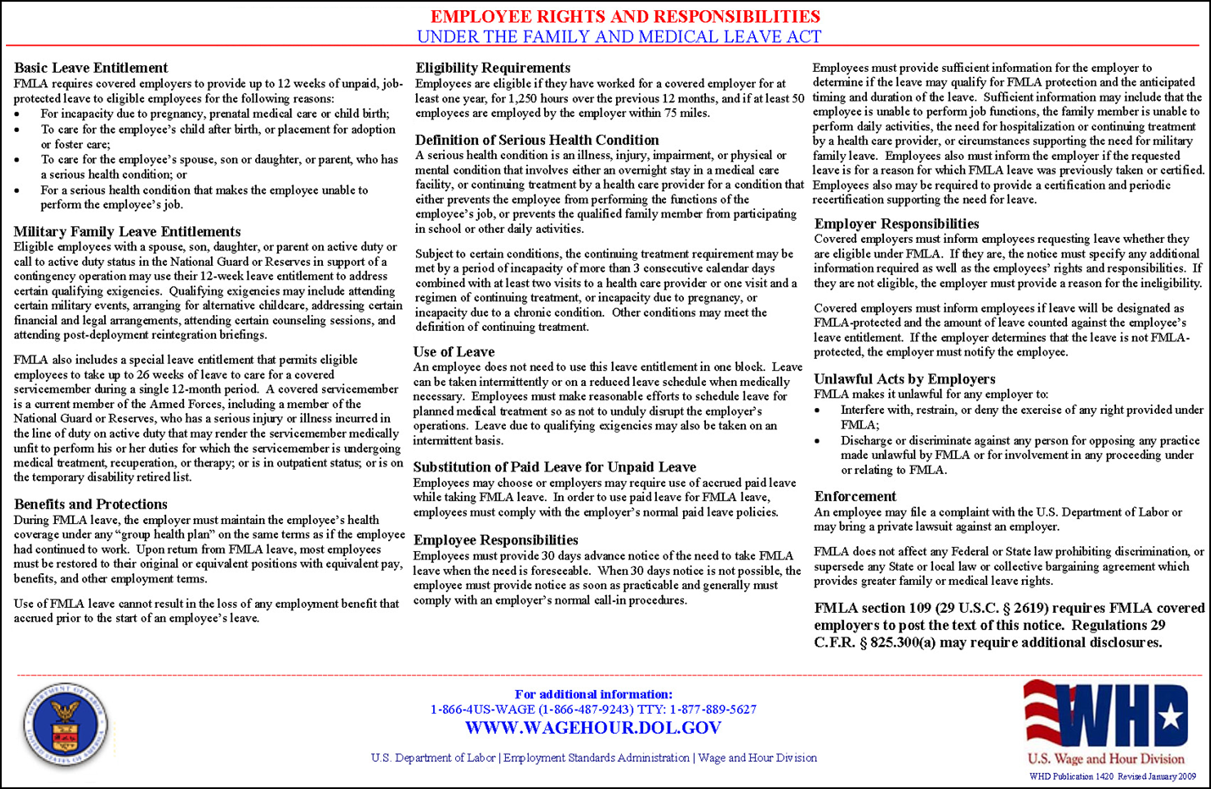
Family and Medical Leave Act

